Slide 1
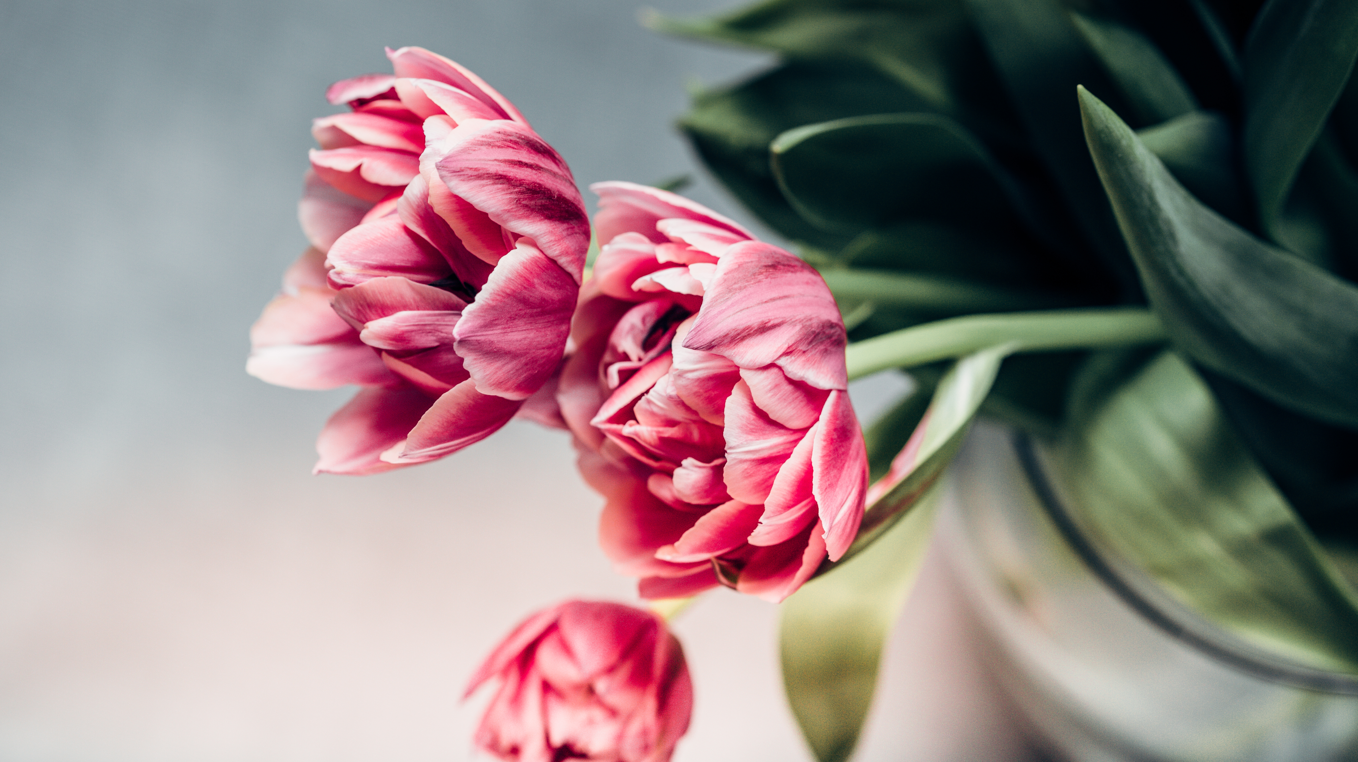
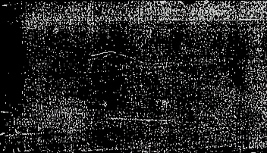
WELCOME

Slide 2

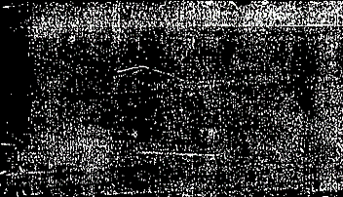
AUTOMATED IMAGE COLORIZATION
Submitted by,
Aswathy Devi M L
MCT19MCA001

Slide 3
INTRODUCTION
A number of proposed solutions are available for colorization of black and white images.
There is a lot of research going on in this field to obtain images as realistic as possible.
Image colorization is a difficult problem that often requires user input to be successful.
To evaluate a new approach to automatically colorize black and white images of nature without direct user input.
Automated colorization of black and white images has been subject to much research within the computer vision and ML.

Slide 4
Continue………….
Given a grayscale photograph as input,this paper attacks the problem of hallucinating a plausible color version of the photograph.
I propose a fully automatic approach that produces vibrant and realistic colorizations.
However, for this paper our goal is not necessarily to recover the actual ground truth color, but rather to produce a plausible colorization that could potentially fool a human observer.

Slide 5
Image colorization is the process of adding color to grayscale or sepia images, usually with the intent to modernize them.
By hand, this can be a time consuming and repetitive process, and thus would be useful to automate.
Colorization is fundamentally an ill-posed problem - two objects with different colors can appear the same on grayscale film.

Slide 6
Coloring Problem:
Gray image coloring or “colorization” means to give color gray images.
It become a new research point area since it is utilized to increase the visual appeal of images such as old black and white photos,movies or scientific illustrations.
The problem of coloring there are two
Intensity(most common used):
Gray=(red+green+blue)
Luminance

Slide 7
SOFTWARE TOOLS
LUMINAR
PHOTOMYNE
PIXBIM
PHOTOSHOP
MOVAVI

Slide 8
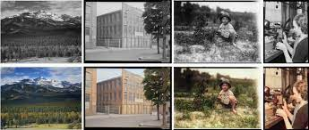
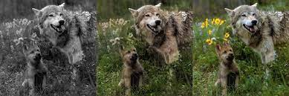
SAMPLE OUTPUT

Slide 9
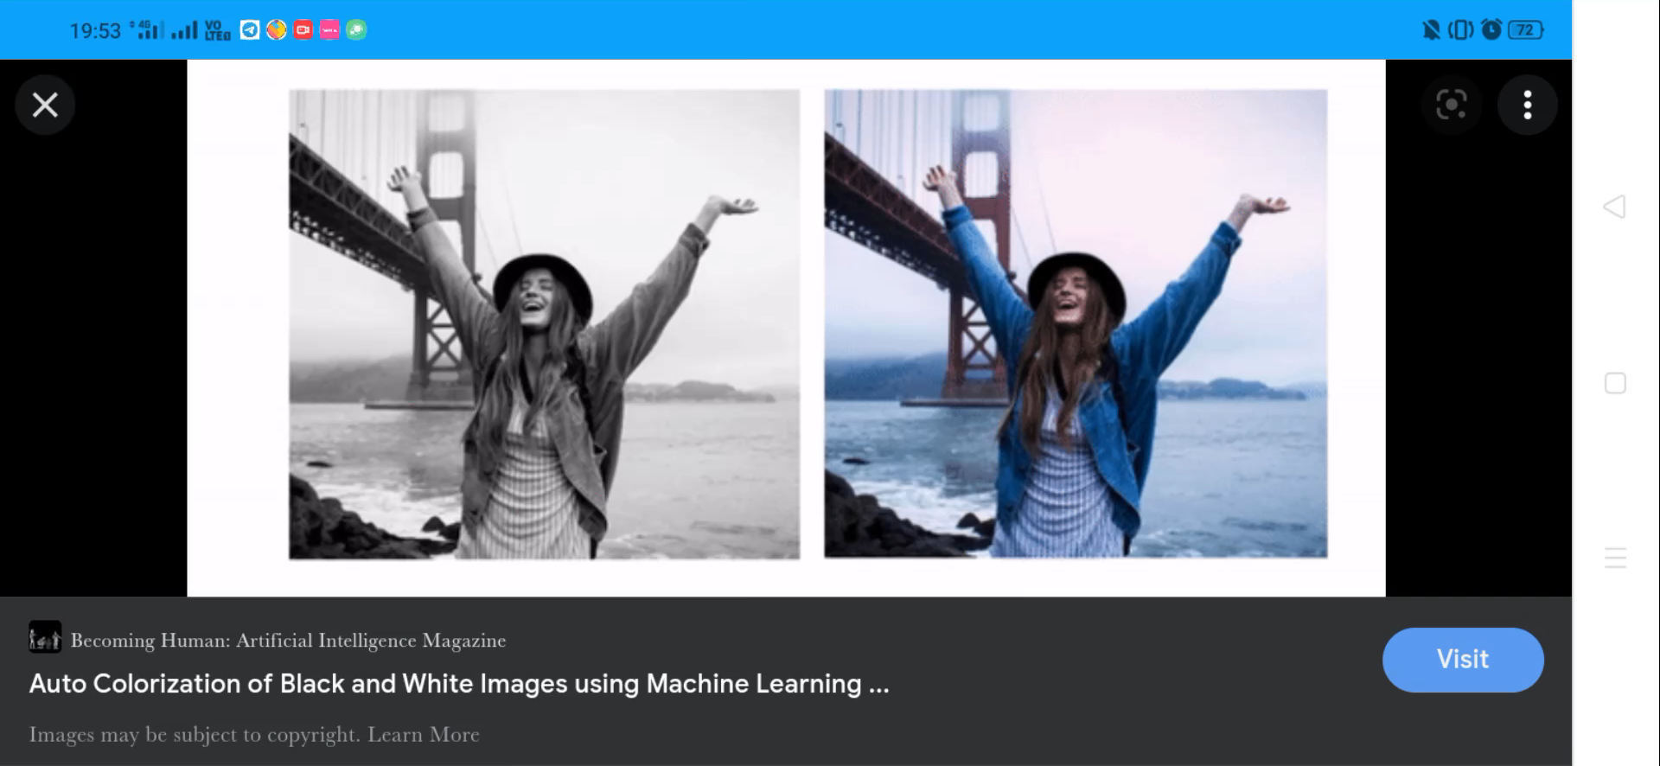
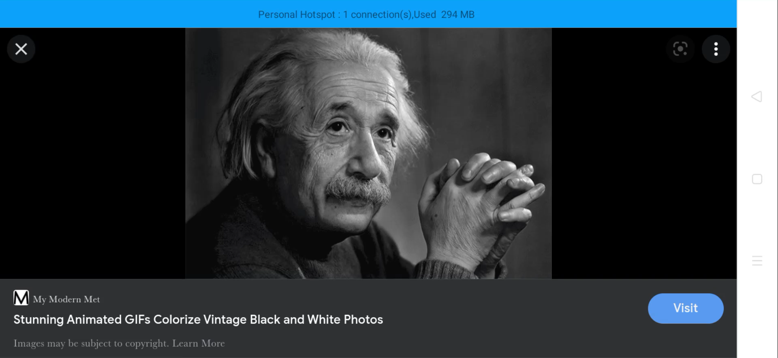
IMAGE COLORIZATION

Slide 10
Conclusion
In image colorization our goal is to produce a colored image given a grayscale input image..
This problem is challenging because it is multimodal--- single grayscale image may correspond to many plausible colored images.
As a result,traditional models often relied on significant user input alongside a grayscale .
While image colorization is a boutique computer graphics,it is also an instance of a difficult pixel prediction problem in computer vision.
Recently, deep neural networks have shown remarkable success in automatic image colorization—going from grayscale to color with no additional human input.

Slide 11
Thank You ………………………..

